Slide 1
Global Urban to Rural Population Ratio and Economic Health of a Nation
By Manoj Dey, Hamed Yazarloo, and Gautam Gupta

Slide 2
Questions & Data
Question 1: Does urbanization contribute to economic growth?
Question 2: How have incomes changed over time in countries across the world?
Question 3: How large are the differences in GDP between countries?

Slide 3

Questions & Data continued
Data Source: https://ourworldindata.org/economic-growth
Notes:
Excel files:
Urbanization-vs-gdp (shows countries, year, %population living in urban areas, gdp per capita, total population)
Gdp-per-capita-in-us-dollar-world-bank (shows countries, year, gdp per capita, focused on US)
World-gdp-over-the-last-two-millennia (shows average gdp over years in world)

Slide 4
Motivation & Summary
Hypothesis 1: Urbanization brings economic prosperity.
Hypothesis 2: Economic growth is a relatively recent development in human history.
Hypothesis 3: Economic development is not well distributed across the globe.

Slide 5
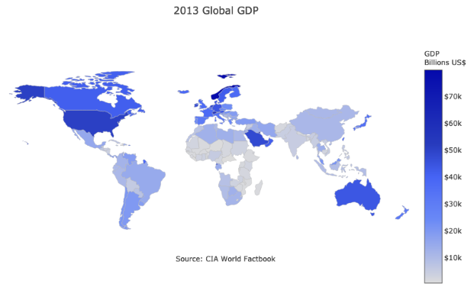
Motivation & Summary continued
Notes:
We were able to find our answers and our predictions were shown correct, for each of the three questions we had come up with.
We found for question one (Does urbanization contribute to economic growth?), that urbanization has a positive impact on economic growth.
We have found for question two(How have incomes changed over time in countries across the world?), that incomes have increased .
We found for question three(How large are differences in GDP between countries?) that differences are significant.

Slide 6
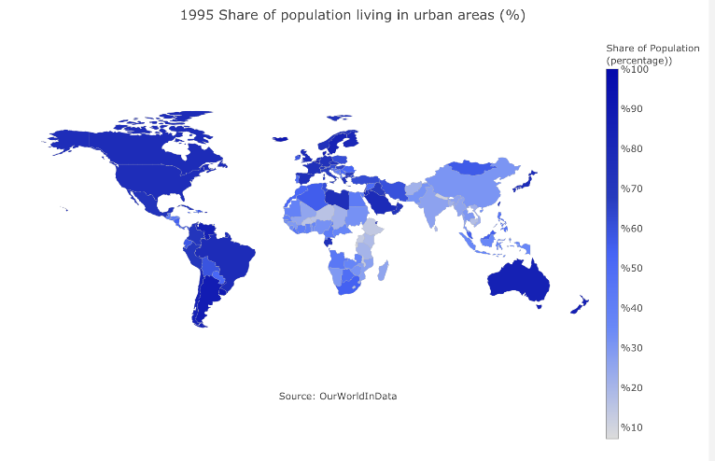
Motivation & Summary continued
Notes:
We were able to find our answers and our predictions were shown correct, for each of the three questions we had come up with.
We found for question one (Does urbanization contribute to economic growth?), that urbanization has a positive impact on economic growth.
We have found for question two(How have incomes changed over time in countries across the world?), that incomes have increased .
We found for question three(How large are differences in GDP between countries?) that differences are significant.

Slide 7
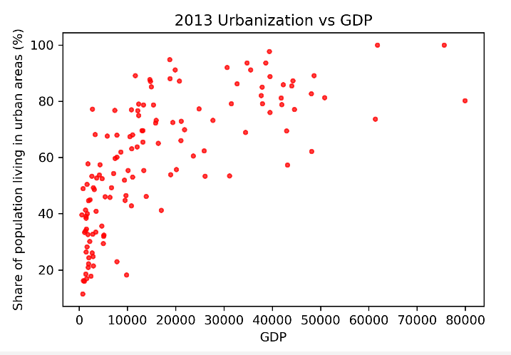
Motivation & Summary continued
Notes:
We were able to find our answers and our predictions were shown correct, for each of the three questions we had come up with.
We found for question one (Does urbanization contribute to economic growth?), that urbanization has a positive impact on economic growth.
We have found for question two(How have incomes changed over time in countries across the world?), that incomes have increased .
We found for question three(How large are differences in GDP between countries?) that differences are significant.

Slide 8
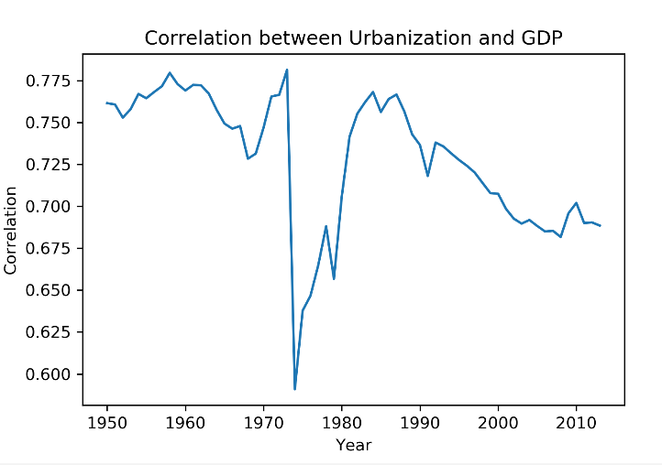
Motivation & Summary continued
Notes:
We were able to find our answers and our predictions were shown correct, for each of the three questions we had come up with.
We found for question one (Does urbanization contribute to economic growth?), that urbanization has a positive impact on economic growth.
We have found for question two(How have incomes changed over time in countries across the world?), that incomes have increased .
We found for question three(How large are differences in GDP between countries?) that differences are significant.

Slide 9
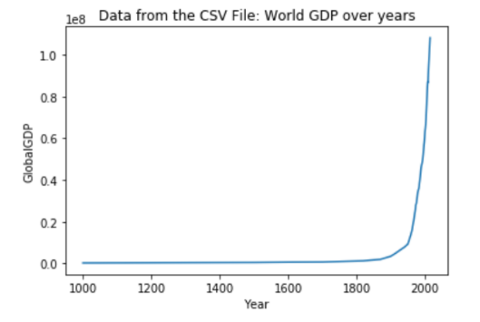
Motivation & Summary continued
Notes:
We were able to find our answers and our predictions were shown correct, for each of the three questions we had come up with.
We found for question one (Does urbanization contribute to economic growth?), that urbanization has a positive impact on economic growth.
We have found for question two(How have incomes changed over time in countries across the world?), that incomes have increased .
We found for question three(How large are differences in GDP between countries?) that differences are significant.

Slide 10
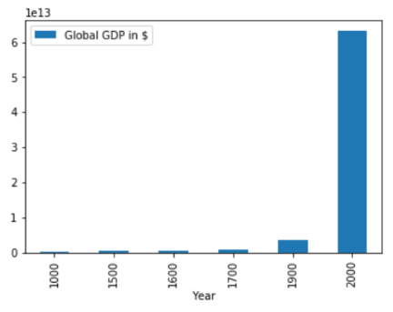
Motivation & Summary continued
Notes:
We were able to find our answers and our predictions were shown correct, for each of the three questions we had come up with.
We found for question one (Does urbanization contribute to economic growth?), that urbanization has a positive impact on economic growth.
We have found for question two(How have incomes changed over time in countries across the world?), that incomes have increased .
We found for question three(How large are differences in GDP between countries?) that differences are significant.

Slide 11
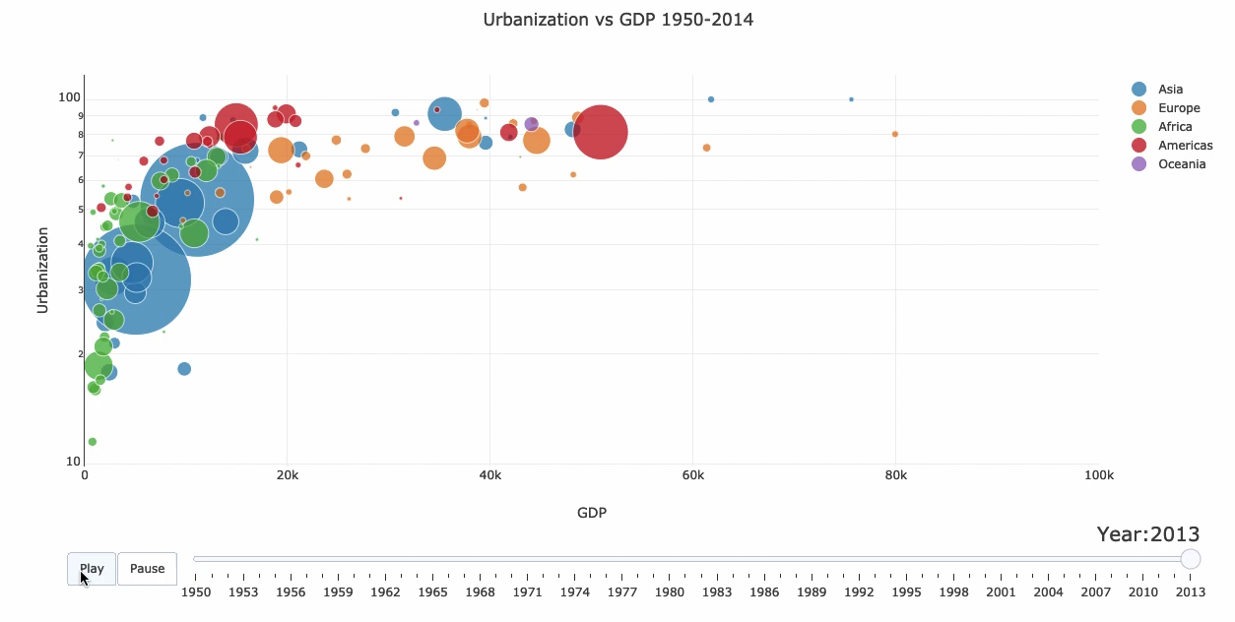
Motivation & Summary continued
Notes:
We were able to find our answers and our predictions were shown correct, for each of the three questions we had come up with.
We found for question one (Does urbanization contribute to economic growth?), that urbanization has a positive impact on economic growth.
We have found for question two(How have incomes changed over time in countries across the world?), that incomes have increased .
We found for question three(How large are differences in GDP between countries?) that differences are significant.

Slide 12
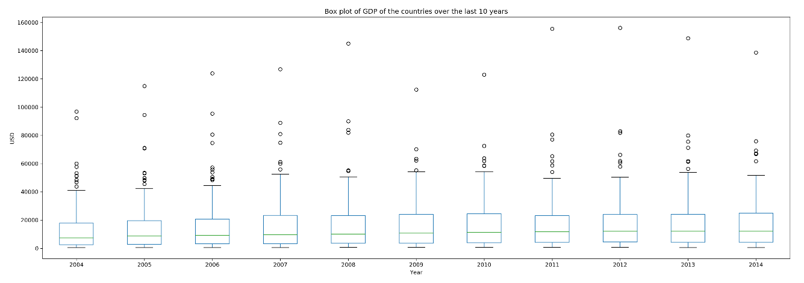
Motivation & Summary continued
Notes:
We were able to find our answers and our predictions were shown correct, for each of the three questions we had come up with.
We found for question one (Does urbanization contribute to economic growth?), that urbanization has a positive impact on economic growth.
We have found for question two(How have incomes changed over time in countries across the world?), that incomes have increased .
We found for question three(How large are differences in GDP between countries?) that differences are significant.

Slide 13

Data Cleanup & Exploration
Slide 11 was specifically interesting due to the animation of the graph.
Notes:
Furthermore we noticed that all of our graphs have a positive correlation in general.

Slide 14

Data Analysis
Notes:
We felt for question one (Does urbanization contribute to economic growth?) that a scatter plot would be best. Although we thought the relationship would be positive, we felt that there could be times where the data seemed to be all over the place. In the scatter plot we felt that the data could best be depicted to show a trend.
We have felt for question two (How have incomes changed over time in countries across the world?) that a line graph would be best to depict this kind of data since we suspected the correlation to be strictly positive.
We felt that for question three (How large are differences in GDP between countries?), the box plot could best show this data. When we talk about how large a difference is, we want to take the average, and other statistical measures such as the mean, median, and mode.

Slide 15

Discussion
Our findings matched our prediction.
Notes:
We found out, from the results, that :
Urbanization does bring economic prosperity
Economic growth is a relatively recent development in human history.
Economic development is not well distributed across the globe.

Slide 16

Post Mortem
If we had more time in the project, we could maybe have incorporated specific factors that contribute to GDP the most, to have a more narrow analysis.
Notes:
Difficulties: It was difficult to find a topic initially, because we could not find many appealing topics on kaggle that we could mutually agree upon. We overcame this hurdle of agreeing on a topic by brainstorming and making venn diagram of each topic we individually wanted, comparing and contrasting which one was best to do, and later we came to an agreement.

Slide 17

Questions

